Slide 1
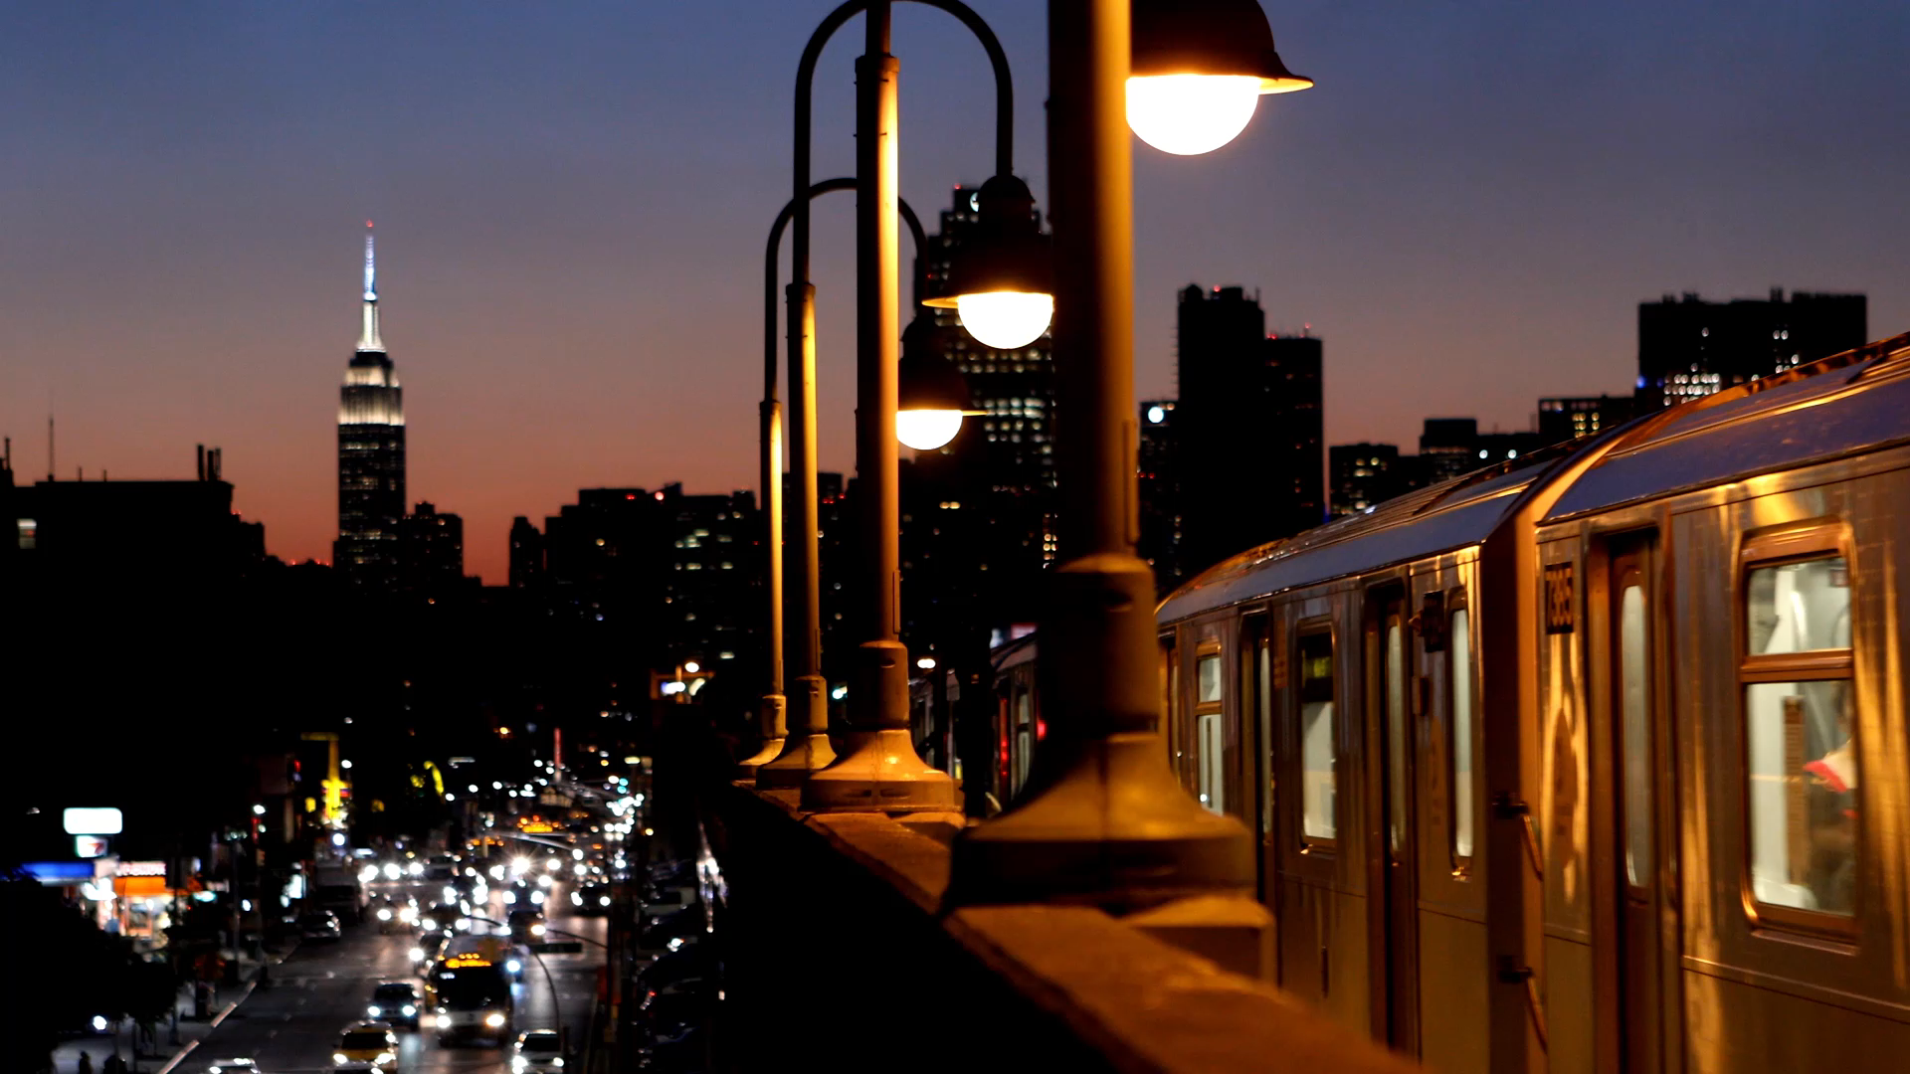
Findr ™ presents Movie Findr
Jacob McCarthy- Henri Harilal – Eldana Desalgne

Slide 2

Welcome to Findr™

Slide 3

User Story Findr™
It is a application that makes your life a little bit easier.
Dedicate to helping you locate your next nearest date adventure.
We are going to be answering the question: you found someone, now what?
Notes:
The future of in person dating-

Slide 4



How it works?
The Findr™ is working to clean up a problem that dating apps create to make the services even more useful to you when the question of now what comes to fruition.

Slide 5

Movie Findr™
As phase 1 MVP

Slide 6
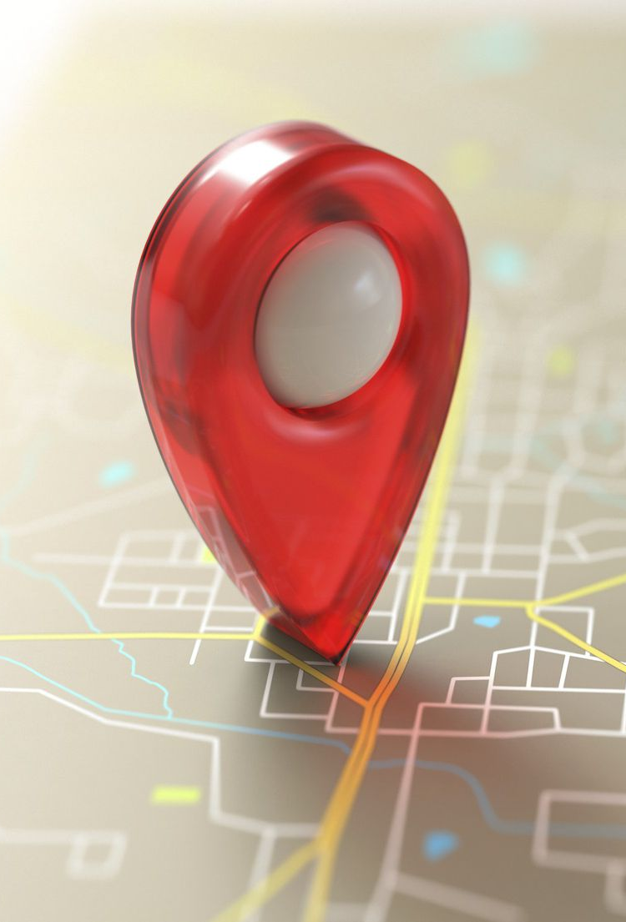
Movie Findr
With this, we have added the movie’s category to launch our product.
This website will help people to meet in person at a location most convenient to themselves.
Specifically, within a 10-mile radius.

Slide 7
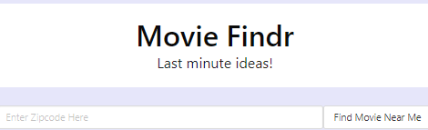
Movie Findr
30326
Requirement:
Input = Zip code
And that’s it!

Slide 8
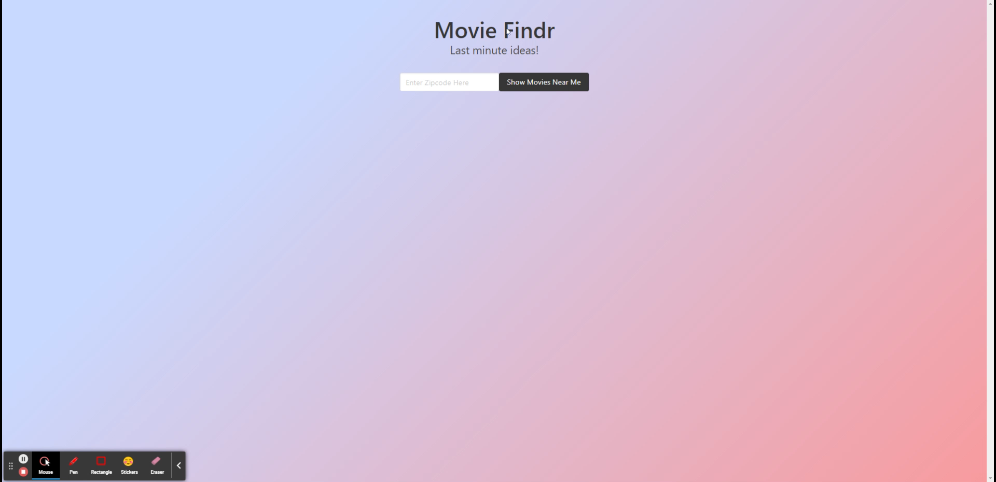

Slide 9

Let’s Do A live Demo…

Slide 10

Movie Findr- Technology
API #1: TMDB
API #2: Grace Note Video
CSS Framework: BULMA- https://bulma.io/
Others

Slide 11

What’s works and what doesn’t?
Success
Needs more work
Ability to accept any Zip Code
Ability to gather data of movies playing within a 10-mile radius
Ability to display showtimes and location
Git hub push success~
Adding a link to the movies playing and time for the tickets- in the modal.
Having more description for the movies
Getting more calls per API, for free
Being able to have a login and to store the date idea~

Slide 12

What’s next for our team?

Slide 13
More Additions to Directions for Future Development…
Food Findr™
Event Findr™
And other products, soon to come.

Slide 14

Sources and Links
GitHub: https://github.com/ed2022/Movie_Findr.git Webpage: https://ed2022.github.io/Movie_Findr/ API #1: TMDB API #2: Grace Note Video CSS Framework: BULMA- https://bulma.io/

